Slide 1
Loan applicant information
The data contains loan applicant information collected by a US credit bureau. Each row represents a single loan application and the information gathered on the applicant at the time of the application.
Historical data are provided on 150,000 borrowers.

Slide 2
Dictionary
Variable Name | Description | Type
SeriousDlqin2yrs | Person experienced 90 days past due delinquency or worse. | Y/N
RevolvingUtilizationOfUnsecuredLines | Total balance on credit cards and personal lines of credit except real estate and installment debt (e.g. car loans) divided by the sum of credit limits. | Percentage
age | Age of borrower in years. | Integer
NumberOfTime30-59DaysPastDueNotWorse | Number of times borrower has been 30-59 days past due but no worse in the last 2 years. | Integer
DebtRatio | Monthly debt payments, alimony, and living costs divided by monthly gross income. | Percentage
MonthlyIncome | Monthly income. | Dollars
NumberOfOpenCreditLinesAndLoans | Number of open loans (e.g. car loan, mortgage) and lines of credit (e.g. credit cards). | Integer
NumberOfTimes90DaysLate | Number of times borrower has been 90 days or more past due. | Integer
NumberRealEstateLoansOrLines | Number of mortgage and real estate loans including home equity lines of credit. | Integer
NumberOfTime60-89DaysPastDueNotWorse | Number of times borrower has been 60-89 days past due but no worse in the last 2 years. | Integer
NumberOfDependents | Number of dependents in family excluding applicant (spouse, children, etc...). | Integer

Slide 3
Observations – part 1
MonthlyIncome and NumberOfDependents have 29731 (19.82%) and 3924 (2.61%) null values respectively
NumberOfTimes90DaysLate, NumberOfTime60-89DaysPastDueNotWorse, NumberOfTime30-59DaysPastDueNotWorse share the same values, specifically 96 and 98.
We can see that sharing the same values of 96 and 98 respectively is not logical since trivial calculations can reveal that being 30 days past due for 96 times for a single person within a timespan of 2 years is not possible.
RevolvingUtilizationOfUnsecuredLines
Defined as ratio of the total amount of money owed to total credit limit distribution of values is right-skewed, consider removing outliers
The minimum value of this column is set to 13, the proportion of defaulters is smaller than that belonging to the pool of clients with total amount of money owed not exceeding total credit limit.

Slide 4
Observations – part 2
DebtRatio
2.5% of clients owe around 3490 or more times what they own
For the people who have monthly income in this 2.5%, only 185 people have values for their monthly incomes and the values are either 0 or 1.
There are 164 out of these 185 people who are of two different types, first with no monthly income and does not default and second with monthly income and does default.
MonthlyIncome
Distribution of values is skewed, you can consider imputation with median.
You can also consider imputing with normally distributed values with its mean and standard deviation.

Slide 5
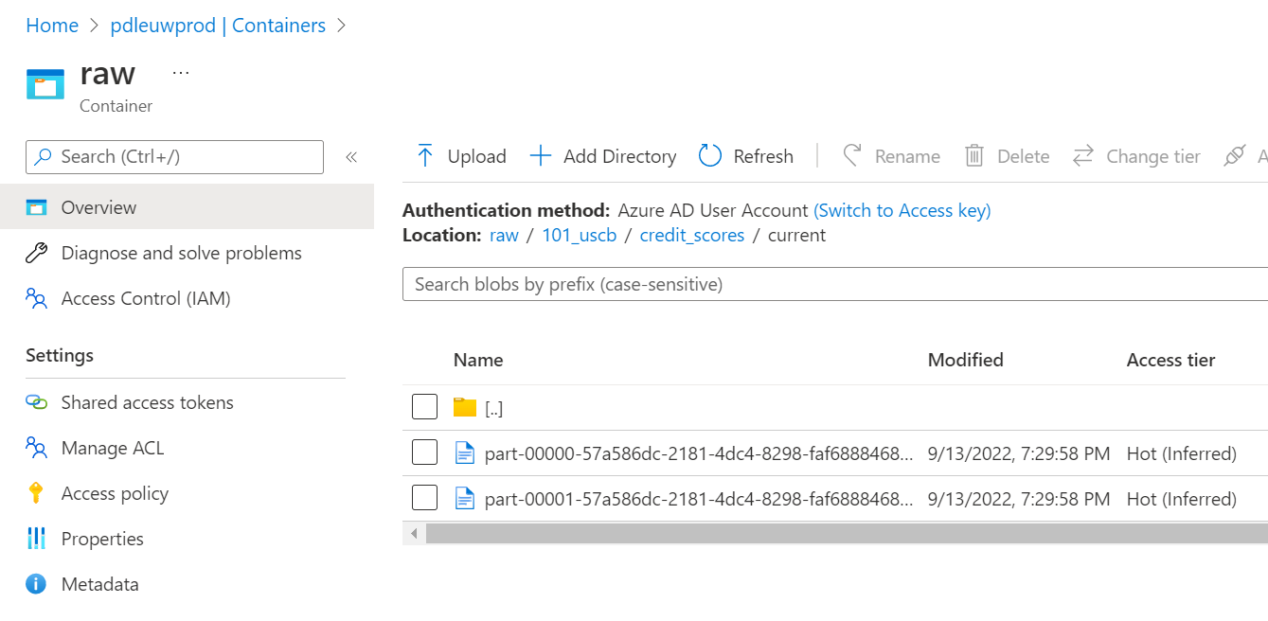
Latest data location https://pdleuwprod.dfs.core.windows.net/raw/101_uscb/credit-scores/current/*.parquet

Slide 6
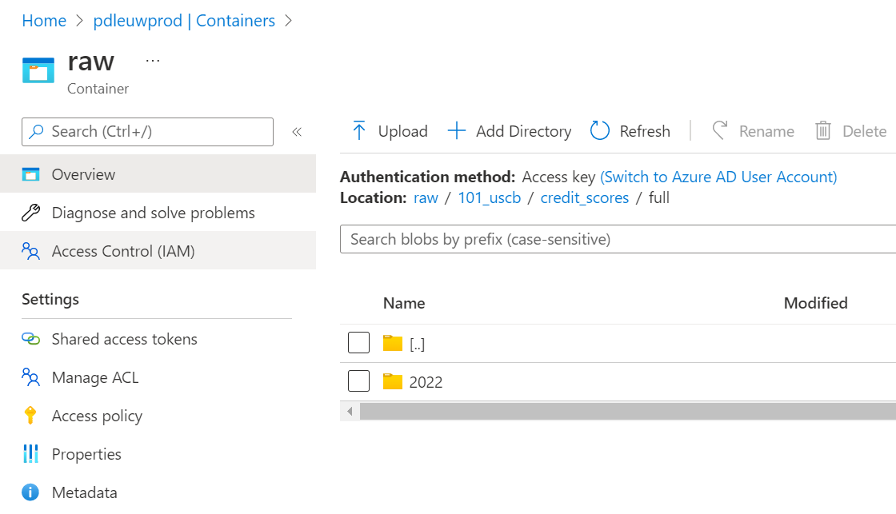
Historical data location https://pdleuwprod.dfs.core.windows.net/raw/ 101_uscb/credit_scores/full/yyyy/mm/dd/HH/*.parquet

Slide 7
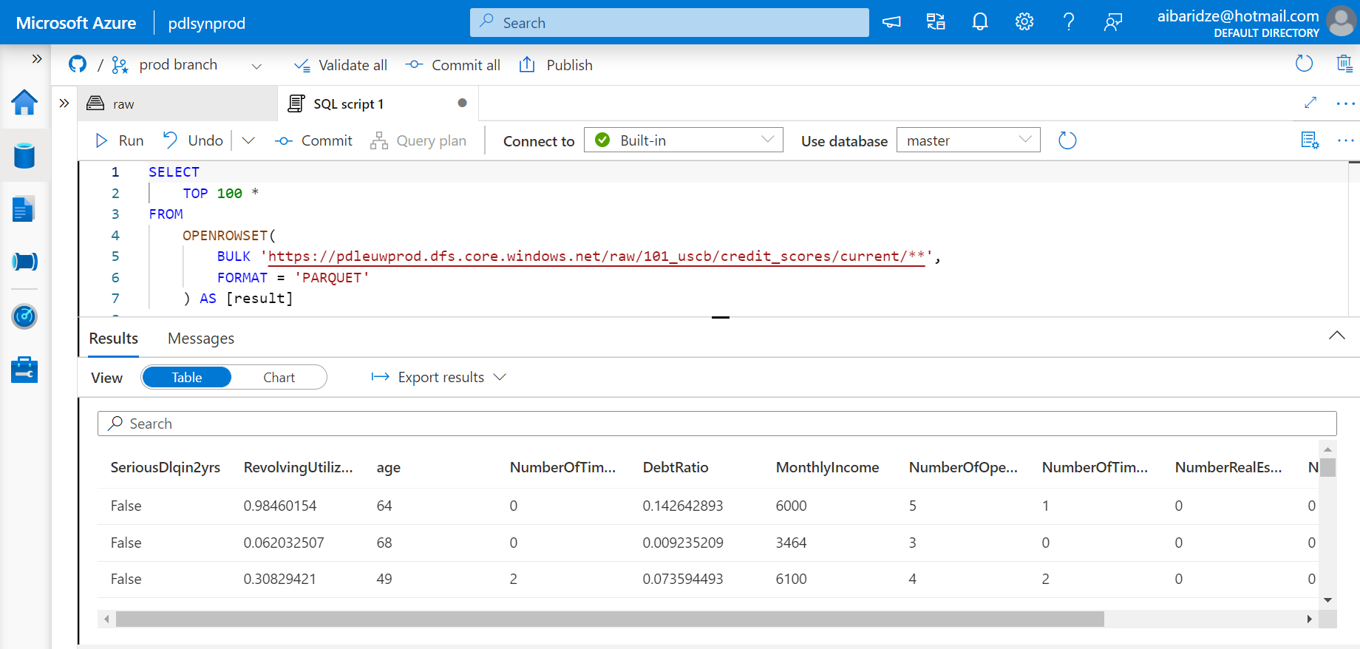
Data Exploration Synapse Analytics instance: pdlsynprod, use Serverless SQL Pool.

Slide 8
Data Access Request
Since data is located at raw folder 101_uscb, access should be requested from its Informational Steward – John Doe.
Access can be granted to Azure Active Directory groups , service principals, and managed identities.
If you need personal access, specify an Azure Active Directory group (AAD) of which you should be a member.
If you need programmatic access – use either service principals or managed identities, they also can be included as members in AAD groups.

